Slide 1
Module 2 (COA )
Nilanjan Byabarta

Slide 2
Implementing the ALU
Must support the arithmetic/logic operations
Tradeoffs of cost and speed based on frequency of occurrence, hardware budget.
operation
a
32
ALU
result
32
b
32

Slide 3
Negating a two's complement number: invert all bits and add 1
remember: “negate” and “invert” are quite different!
Converting n bit numbers into numbers with more than n bits:
MIPS 16 bit immediate gets converted to 32 bits for arithmetic
copy the most significant bit (the sign bit) into the other bits 0010 -> 0000 0010 1010 -> 1111 1010
"sign extension" (lbu vs. lb)

Slide 4
Just like (carry/borrow 1s) 0111 0111 0110 + 0110 - 0110 - 0101
Two's complement operations easy
subtraction using addition of negative numbers 0111 + 1010
Overflow (result too large or too small for finite computer word):
Example: -8 <= 4-bit binary number <=7

Slide 5
No overflow when adding a positive and a negative number
No overflow when signs are the same for subtraction
Overflow occurs when the value affects the sign:
overflow when adding two positives yields a negative
or, adding two negatives gives a positive
or, subtract a negative from a positive and get a negative
or, subtract a positive from a negative and get a positive

Slide 6
An exception (interrupt) occurs
Control jumps to predefined address for exception
Interrupted address is saved for possible resumption
Details based on software system / language

Slide 7
Not easy to decide the “best” way to build something
Don't want too many inputs to a single gate
Don’t want to have to go through too many gates
For our purposes, ease of comprehension is important
Let's look at a 1-bit ALU for addition:
Building blocks: AND, OR, Inverter, MUX, etc.
How could we build a 1-bit ALU for add, and, and or?
How could we build a 32-bit ALU?
c_{out} = a b + a c_{in} + b c_{in}
sum = a xor b xor c_{in}

Slide 8
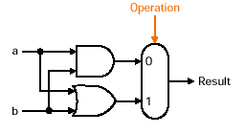
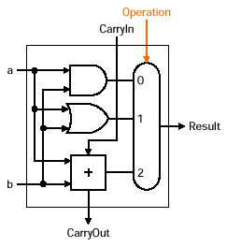
AND and OR
A logic unit performing logic AND and OR.
Full Adder
A 1-bit Full Adder ((3,2) adder).
Implementation of a 1-bit adder
A 1-bit ALU that performs AND, OR, and addition
Figure B.5.6

Slide 9
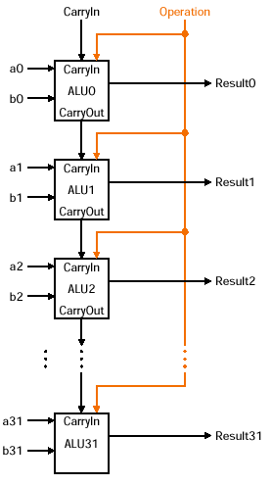
A 32-bit ALU for AND,
OR and ADD operation: connecting 32 1-bit ALUs

Slide 10
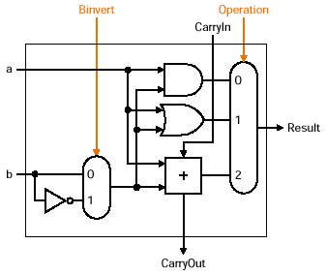
Invert each bit (by inverter) of b and add 1
How do we implement?
A very clever solution: a + (-b) = a + (b’ +1)

Slide 11
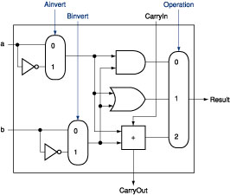
Explore existing hardware in the ALU
NOR (a,b) = not (a or b) = not(a) and not(b)
Only need to add an inverter for input a

Slide 12
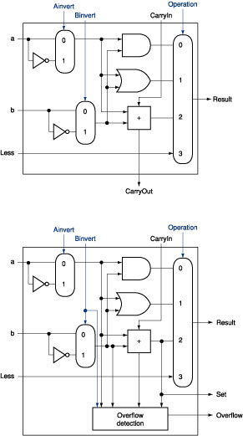
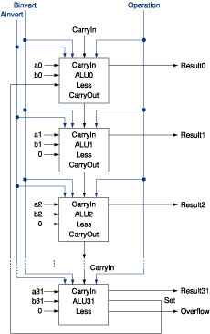
Set on Less Than Operation

Slide 13
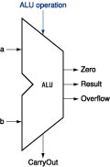
Operations supported: and, or, nor, add, sub, slt, beq/bnq
ALU Control lines: 2 operation control signal for and, or, add, and slt, 2 control line for sub, nor, and slt
ALU Control Lines | Function
0000 | And
0001 | Or
0010 | Add
0110 | Sub
0111 1100 | Slt NOR

Slide 14
Traditional ALU can be built from a multiplexor plus a few gates that are replicated 32 times
Carry lookahead is much faster than ripple carry!
CLA principle can be applied multiple times!

Slide 15
Booths Algorithm (Fixed point Multiplication)
Booth algorithm gives a procedure for multiplying binary integers in signed 2’s complement representation in efficient way
Arithmetic right shift operation

Slide 16
It operates on the fact that strings of 0’s in the multiplier require no addition but just shifting and a string of 1’s in the multiplier from bit weight 2^k to weight 2^m can be treated as 2^(k+1 ) to 2^m.
As in all multiplication schemes, booth algorithm requires examination of the multiplier bits and shifting of the partial product. Prior to the shifting, the multiplicand may be added to the partial product, subtracted from the partial product, or left unchanged according to following rules:

Slide 17
The multiplicand is subtracted from the partial product upon encountering the first least significant 1 in a string of 1’s in the multiplier
The multiplicand is added to the partial product upon encountering the first 0 (provided that there was a previous ‘1’) in a string of 0’s in the multiplier.
The partial product does not change when the multiplier bit is identical to the previous multiplier bit.

Slide 18
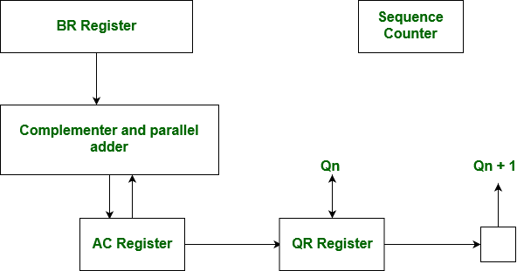

Slide 19
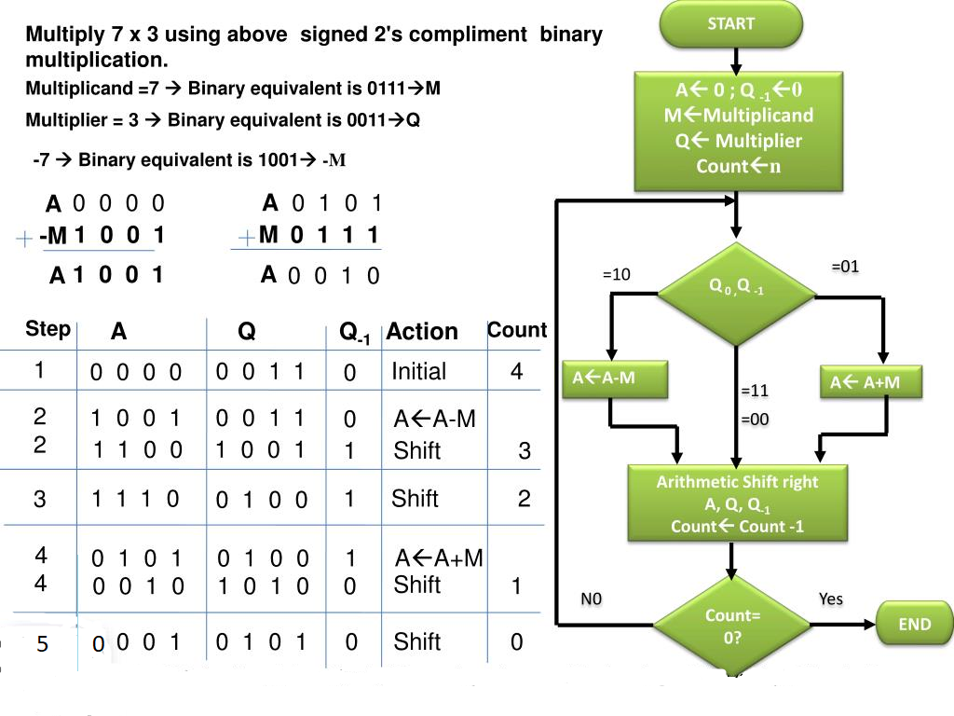

Slide 20
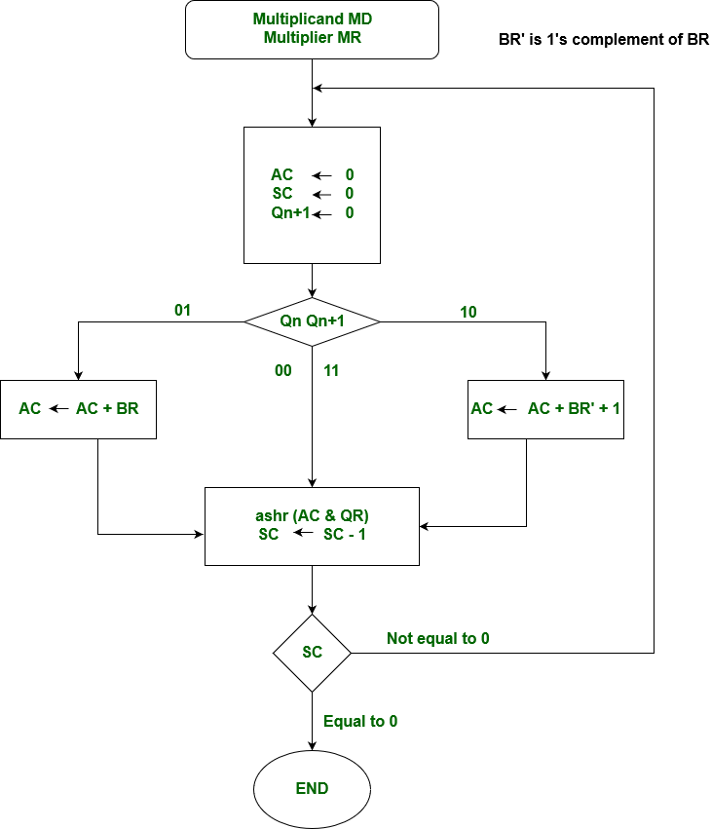
We name the register as A, B and Q, AC, BR and QR respectively. Qn designates the least significant bit of multiplier in the register QR. An extra flip-flop Qn+1is appended to QR to facilitate a double inspection of the multiplier.

